Slide 1
Chapter 4: Intellectual Property

Slide 2
What is Intellectual Property
Property is ownership of any asset
Property can be
Moveable Property
Immoveable property

Slide 3
Charactistics of Intellectual Property
Creation of human mind (Intellect)
Intangible property
Exclusive rights given by statutes
Attended with limitations and exceptions
Time-bound
Territorial

Slide 4
Definition of Intellectual Property
“Intellectual Property shall include the rights relating to literary, artistic and scientific works, performances of performing artists, phonograms, and broadcasts, inventions in all fields of human endeavour, scientific discoveries, Industrial designs, trademarks, service marks and commercial names and designations, protection against unfair competition and all other rights resulting from intellectual activity in the industrial, scientific, literary or artistic fields.”

Slide 5
Why is it important to protect Intellectual Property Rights
Capital expenditure for new products
R and D
Marketing and advertisement
No free loaders
Maintaining loyal followers
profit

Slide 6
Types of Intellectual Property
Copyright and Related Rights
Industrial Property
Patents
Industrial Designs
Trade Marks

Slide 7
The Laws For Intellectual Property Protection
Copyright Act 1987
Trademarks Act 1976
Patent Act 1983
Industrial Design Act 1996
Geographical Indications Act 2000
Law of Tort
-passing-off
Confidential information

Slide 8
Copyright
Copyright is granted in case of literary works (including computer programs, tables and compilations including computer databases which may be expressed in words, codes, schemes or in any other form, including a machine readable medium), dramatic, musical and artistic works, cinematographic films and sound recordings. Copyright law protects expressions of ideas rather than the ideas themselves. Under section 13 of the Copyright Act 1957, copyright protection is conferred on literary works, dramatic works, musical works, artistic works, cinematograph films and sound recording. For example, books, computer programs are protected under the Act as literary works.

Slide 9
Protection for Copyright
Protection given by law for a term of years to the composer, author etc… to make copies of their work..
Work include literary, artistic, musical,films, sound recordings,broadcasts.
Commercial and moral rights.
No registration provision.

Slide 10
Trademark
A name of an enterprise or a Mark capable of being represented graphically, distinguishing the goods or services of one person from those of others e. g., LUX, Godrej, TVS ,Telco, 555, APPLE
Trade Mark can be -sign , words, letters, numbers, drawings, pictures, emblem, colours or combination of colours, shape of goods, graphic representation or packaging or any combination of the above as applied to an article or a product.
Under modern business condition a trademark performs four functions:
1. It identifies the goods / or services and its origin.
2. It guarantees its unchanged quality
3. It advertises the goods/services
4. It creates an image for the goods/ services.

Slide 11
Protection for trade marks
Commercial exploitation of a product
To identify the product, giving it a name
“mark” includes a device, brand, heading, label, ticket, name, signature,word, letter, numeral or any combination.
Does not include sound or smell

Slide 12
Trade marks (cont.)
Can either be registered or not registered
Advantages of registered trade marks
Application can be made for goods and services
Perform certain function such as indication of quality,identifying a trade connection

Slide 13
Patent
The Patents Act, 1970 deals with the patenting of inventions. A person claiming to be an inventor, applies to the controller of Patents, for patent rights. If the application is successful, the person gets a patent right for a certain number of years. During this period nobody can use the invention without the permission of that person.

Slide 14
Protection for patent
Basic idea of granting a patent
“ the applicant applied to the government for the right of patent and in return for the monopoly given he must disclose everything about the invention in the patent document” ( the description)
Duration 20 years.

Slide 15
Patent (cont.)
Patent for invention
Patent can be applied for a product or a process.
Patentable invention must be new,involves an inventive step and industrially applicable
Priority date- first to file

Slide 16
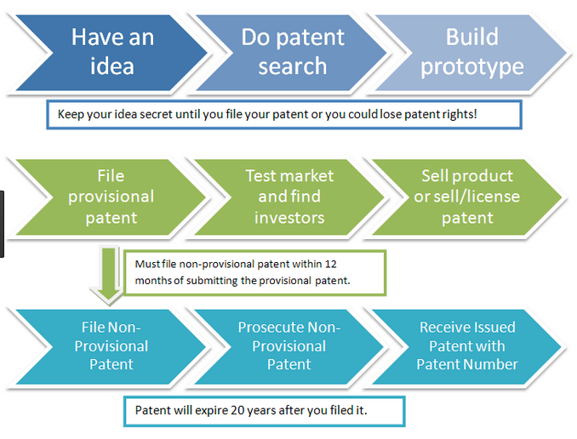
Process of filing a Patent

Slide 17
Protection for industrial designs
Protection for industrial designs that are new or original
Design are feature of shape, configuration, pattern or ornament
The design must be applied to an article
The design must be applied by an industrial process.
Appeal to the eye.

Slide 18
Intellectual Property infringement
Primary infringement
- who does or causes
-making the product
Secondary infringement
- commercial activities
- selling,distribution for sale etc

Slide 19
Thank you

